Slide 1


Slide 2




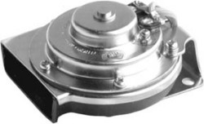
Internet Of Things - Sessions
Arduino - Hello World
Introduction to Arduino
Blinking LED
Arduino - Advanced
Button and photo resistor
Node-Red - Introduction
Introduction to Node-Red, our flagship
Integrating Arduino in Node-Red
Using Json
Using Firmata
The Internet of Things
Introduction to MQTT
Connect to the Internet of Things

Slide 3
https://github.com/rovale/innoexp2

Slide 4

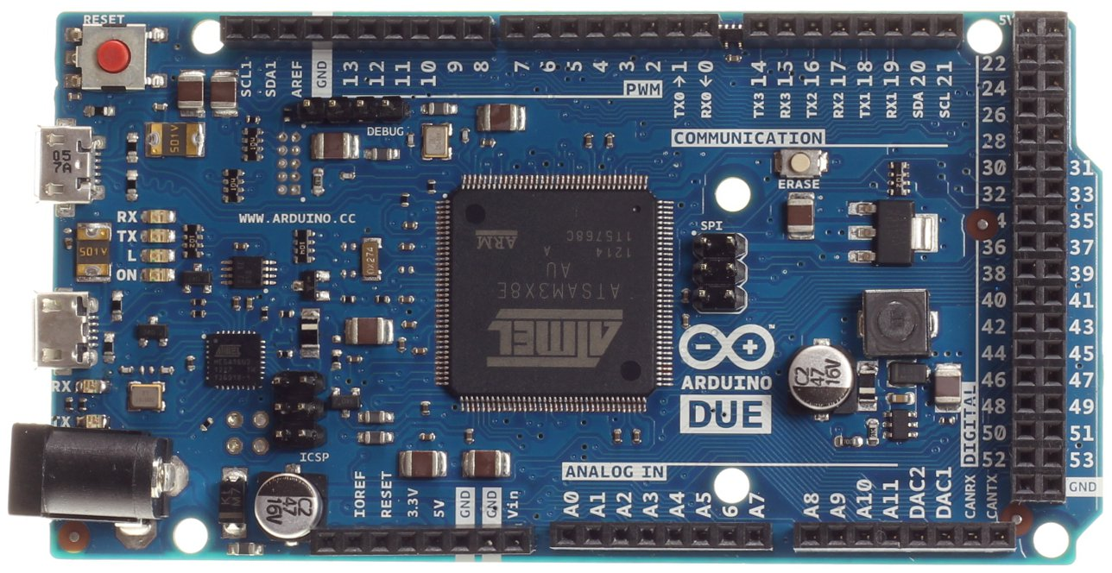
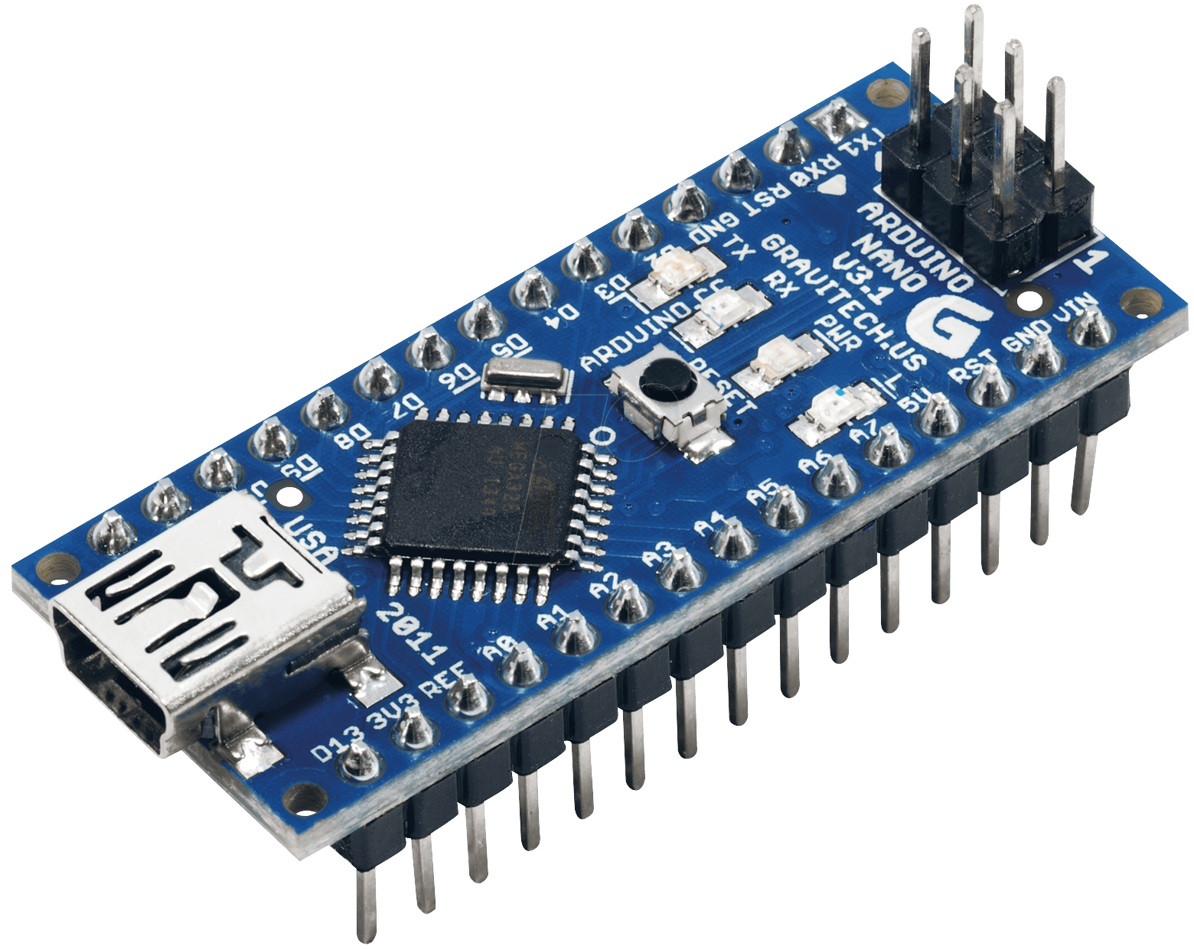

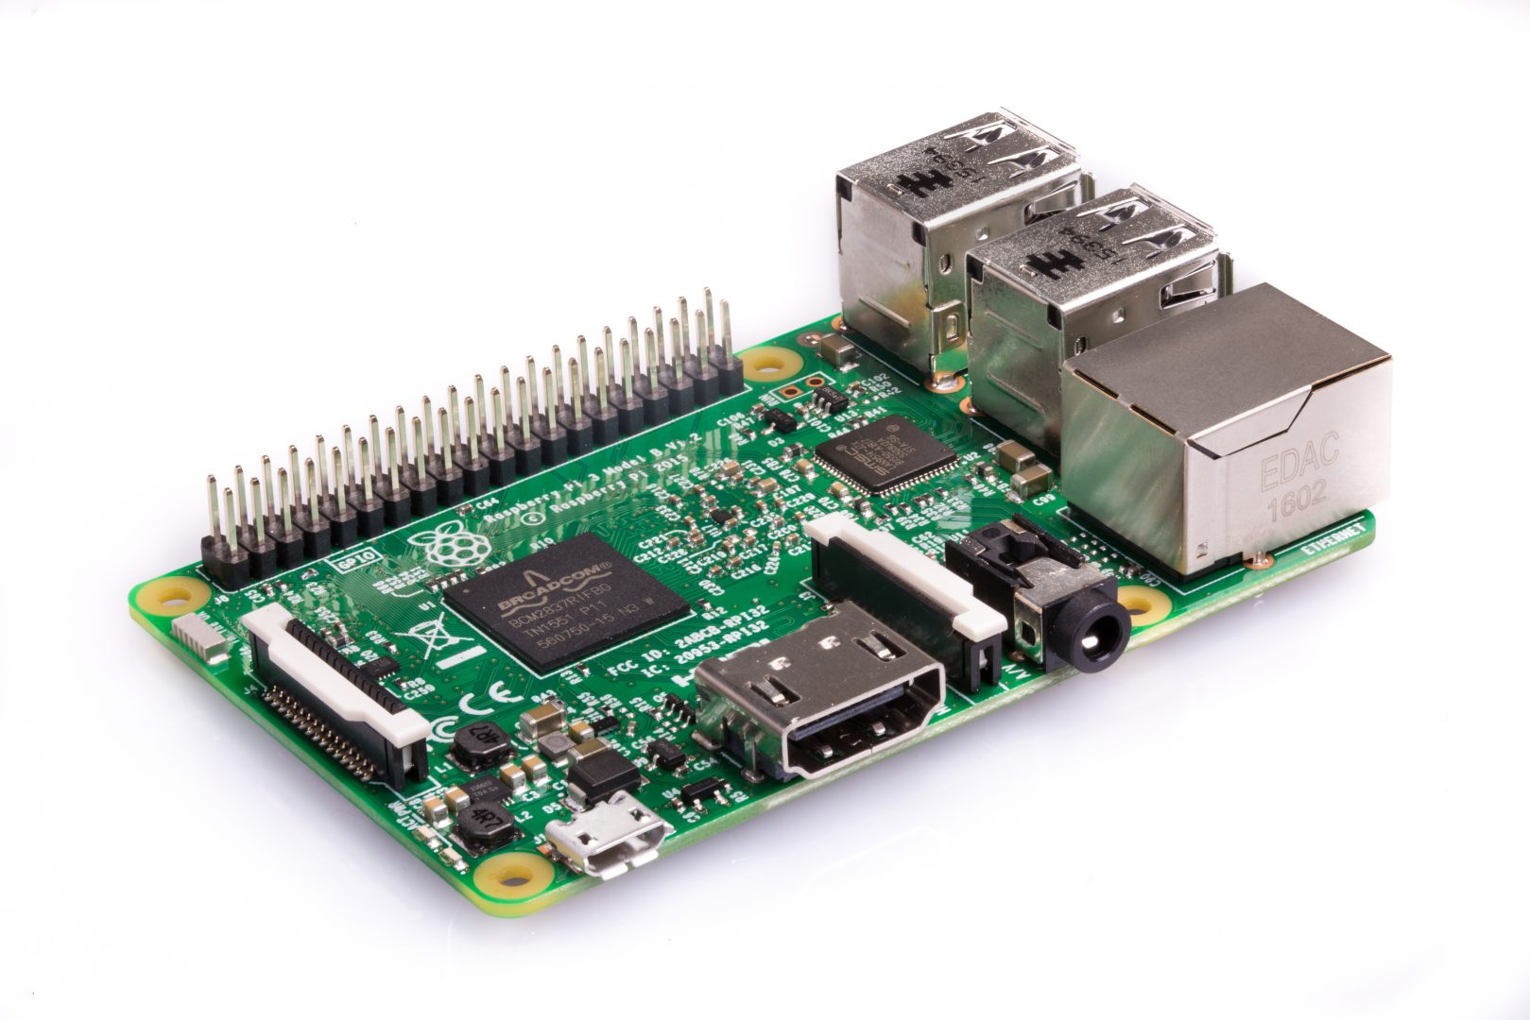
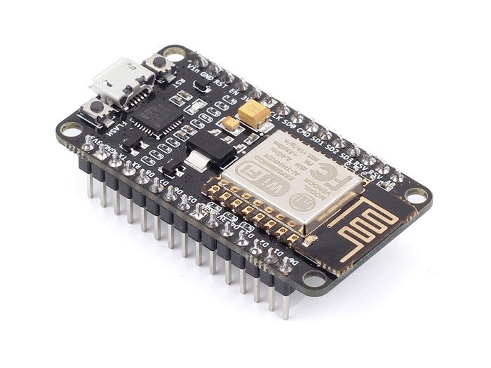
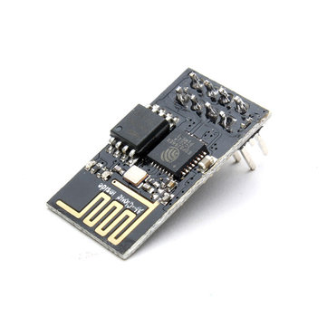



Slide 5
Arduino - Hello World
Arduino Nano
https://store.arduino.cc/usa/arduino-nano
Microcontroller ATmega328
Clock Speed 16 MHz
32 KB flash memory
2 KB SRAM
24 I/O pins
Operating on 5V Other boards may operate on 3.3V!

Slide 6
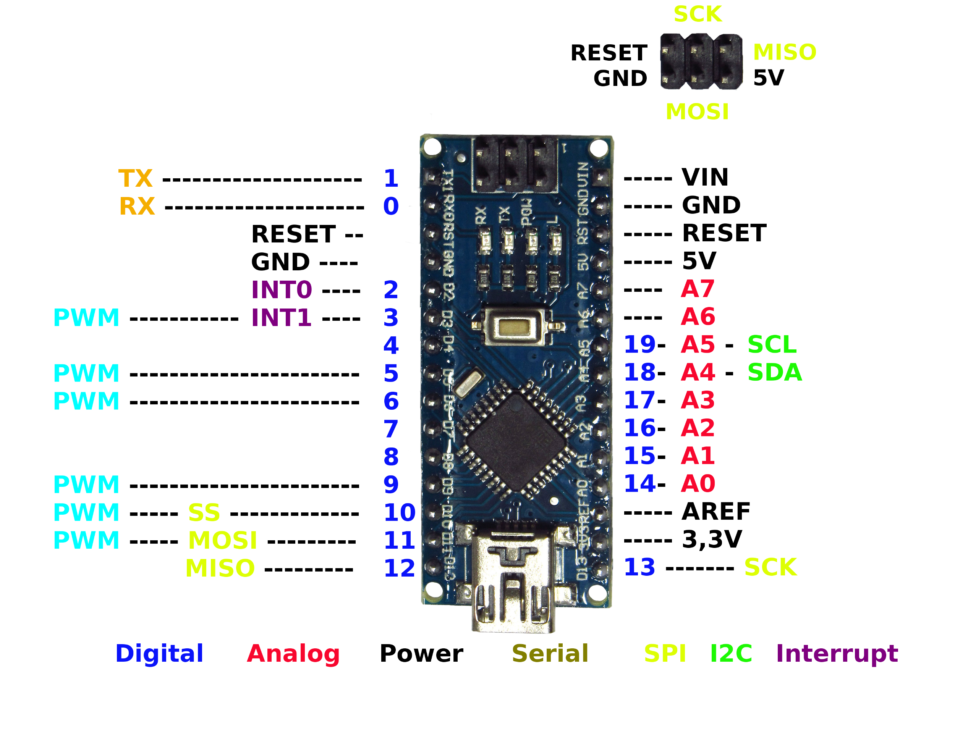
Arduino - Hello World
Arduino Nano
22 I/O pins
4 functions
20 Write digital value (1/0, HIGH/LOW)
HIGH = 5V
LOW = 0V
20 Read digital value (1/0, HIGH/LOW)
HIGH = greater than 3V
LOW = less than 1.5V
6 Write analog value (0 - 255), PWM
8 Read analog value (0 - 1024)

Slide 7
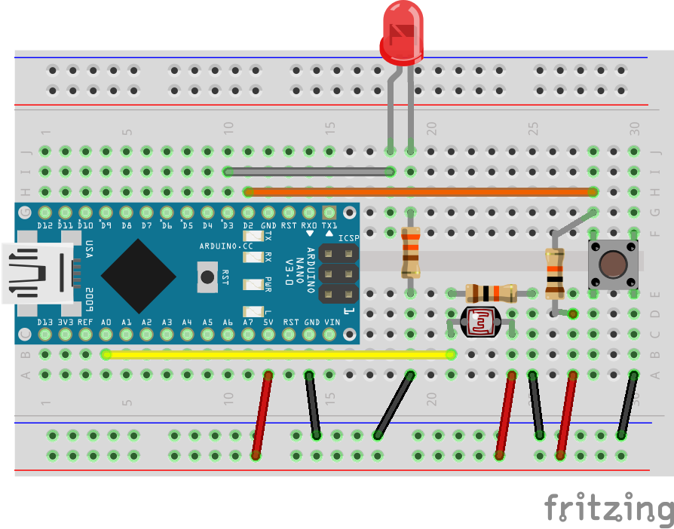
Arduino - Hello World
Prototyping
Breadboard
https://learn.sparkfun.com/tutorials/how-to-use-a-breadboard
Used for creating a prototype of an electronic circuit
Power rails for + and –
Terminal strips for connecting the components
Support for IC's - and the Nano
Connect components using jumper wires

Slide 8
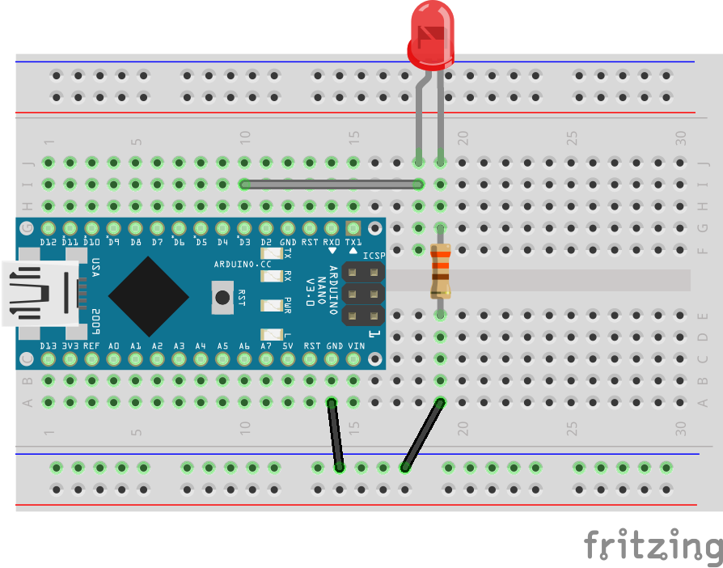
Arduino - Hello World
Digital output example - LED
LED
https://learn.sparkfun.com/tutorials/light-emitting-diodes-leds
An LED is a Light Emitting Diode
Long leg is positive side, anode
Short leg is negative side, cathode - has flat edge
You can test it with a coin cell battery
An LED will be toasted if it gets too much current
Resistor
https://learn.sparkfun.com/tutorials/resistors
A resistor limits the flow of electrons
The value can be decoded using the color bands
Wiring
Arduino pin D3 to LED to Resistor to Ground

Slide 9
Arduino - Hello World
Programming
We got Chinese compatible Nanos here...
Install Serial driver for Nano compatible http://www.wch.cn/download/CH341SER_EXE.html (also needed for NodeMCU V1.0)
Install Arduino IDE https://www.arduino.cc/en/main/software
Select
Board (Arduino Nano)
COM port (see device manager)

Slide 10
Arduino - Hello World
Programming
01-Blink.ino
https://github.com/rovale/Innoexp2/blob/master/Arduino/ 01-Blink/01-Blink.ino
Written in the Arduino programming language
https://www.arduino.cc/reference/en/
Defines a constant with the functional name of the pin
Has a setup and a loop
Turns a digital pin on and off
Uses a delay to time the blinking

Slide 11
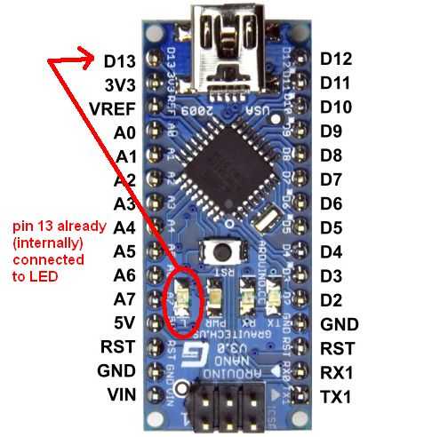
Arduino - Hello World
BTW…
There is also an onboard LED,
on the Arduinos it’s digital pin 13,
constant value of: LED_BUILTIN.

Slide 12
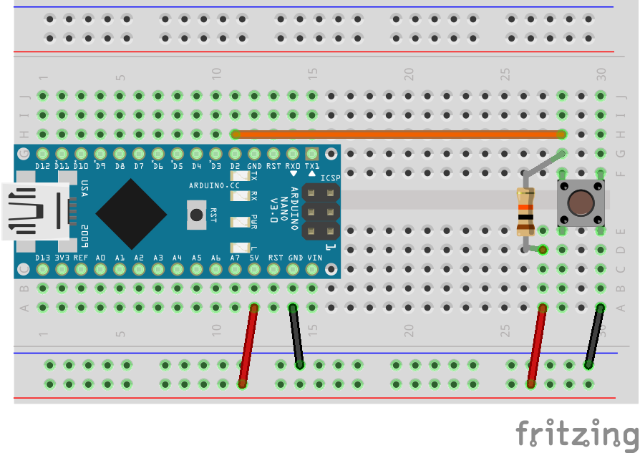
Arduino - Advanced
Digital input example - Button
Circuit
Input pin
Reads a random value when no input is given
Pull-up resistor
https://learn.sparkfun.com/tutorials/ pull-up-resistors
Puts input pin HIGH
Prevents random inputs on the input pin
Button
https://learn.sparkfun.com/tutorials/switch-basics
Digital input -> HIGH / LOW
Puts input pin LOW when pressed
Programming
02-Button.ino
https://github.com/rovale/Innoexp2/blob/master/Arduino/02-Button/02-Button.ino
Turns the LED on when the button is pressed.

Slide 13
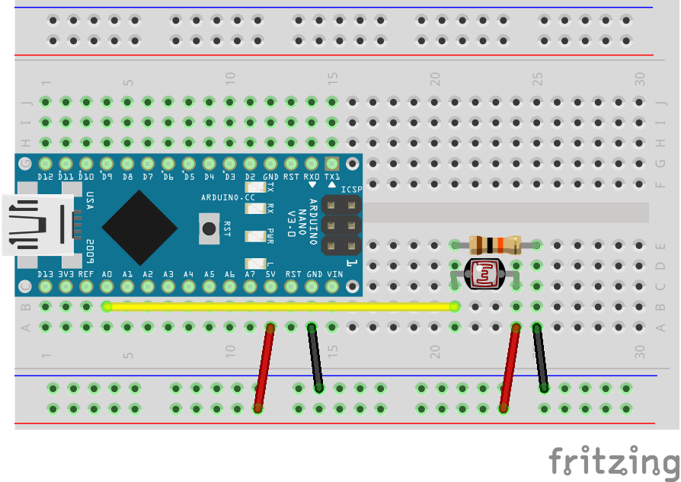
Arduino - Advanced
Analog input example - Photo resistor
Circuit
https://learn.sparkfun.com/tutorials/ photocell-hookup-guide
Light sensitive, variable resistor
More light = less resistance
Pitch black: 1.0MΩ+
Bright light: 0
Analog input (0 – 1024)
Programming
03-PhotoResistor.ino
https://github.com/rovale/Innoexp2/blob/master/Arduino/03-PhotoResistor/03-PhotoResistor.ino
Prints the measured value of a photo resistor to the serial output.
uses a non-blocking pattern to time the print-outs.

Slide 14
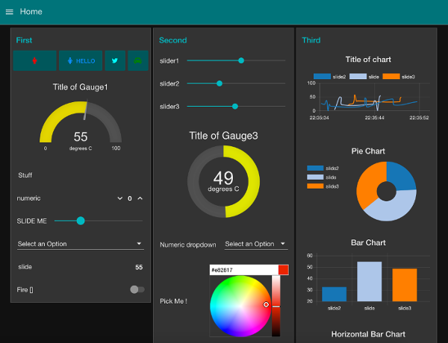
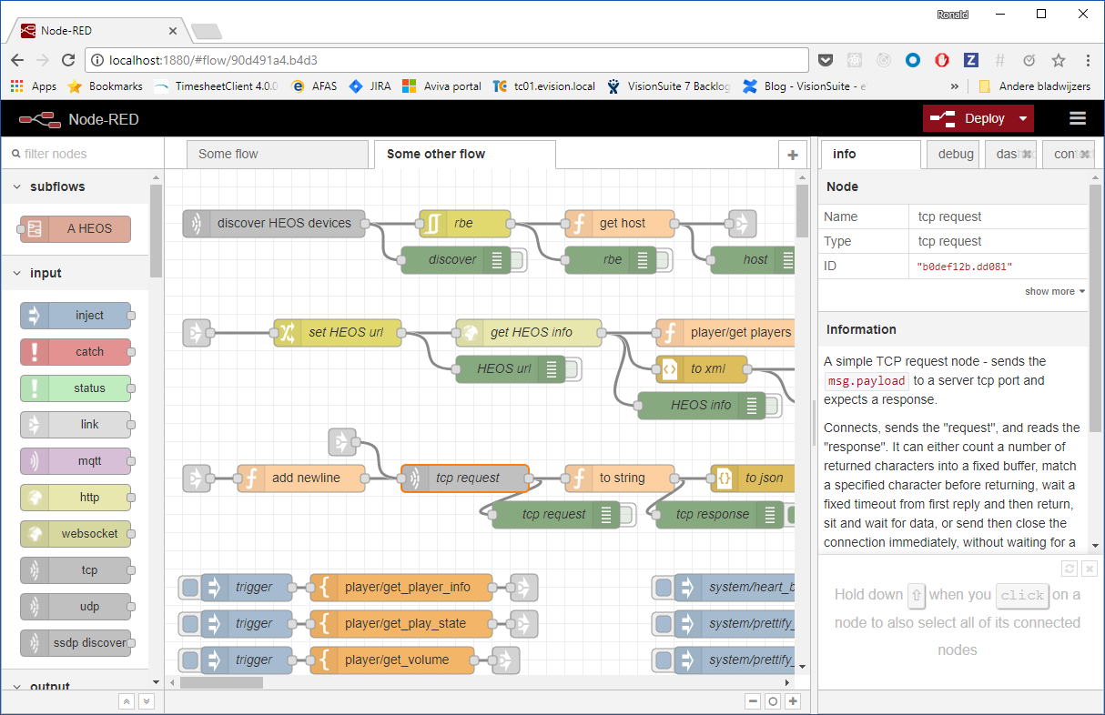
Node-Red - Introduction
https://nodered.org/docs/
This will be our flagship!
Used to wire together our Things, APIs and online services.
Used to create live data dashboards.
Originally developed by IBM and it runs on node.js.
Browser-based editor to create flows of messages and actions.
Deploy to runtime in a single-click.
It can integrate in an existing solution

Slide 15
Integrating Arduino in Node-Red
Goal: connect the Arduino to NODE-Red and display a gauge for the light intensity and a dimmer slider for the LED.
Use Arduino as a serial device:
Using Json
When some logic needs to be programmed on the Arduino.
Using Firmata
When the Arduino is only used as an 'extension' to connect to the physical world.

Slide 16
Integrating Arduino in Node-Red
Json
Arduino programming
04-Json
Uses a library to create / parse Json messages
https://arduinojson.org
Libraries always come with examples.
Uses power modulation (PWM) to dim the LED.
https://www.arduino.cc/en/Tutorial/PWM
Node-RED programming
Flow: Arduino Serial Json
Uses serialport nodes
https://flows.nodered.org/node/node-red-node-serialport
Connects the Arduino directly to the dashboard

Slide 17
Integrating Arduino in Node-Red
Firmata
Arduino programming
Firmata
https://github.com/firmata/protocol
Exposes all Arduino pins on the serial port.
Node-RED programming
Flow: Arduino Firmata
Uses Arduino nodes
https://www.npmjs.com/package/node-red-node-arduino
Also connects the Arduino directly to the dashboard

Slide 18

The Internet of Things
Goal: Connect the Arduino via Node-RED to the Internet of Things using

Slide 19
The Internet of Things
MQTT
https://www.hivemq.com/blog/mqtt-essentials-part-1-introducing-mqtt
Message Queuing Telemetry Transport
The protocol of the Internet of Things
Highlights
Client / broker
Publish / subscribe
Quality of Service
Persistent Sessions
Retained Messages
Last Will

Slide 20
The Internet of Things
Publish / subscribe
A client can publish messages to a topic
Topic: evs/innoexp2/some_device/sensor/light
Payload: 567
A client can subscribe to topics
One topic: evs/innoexp2/some_device/sensor/light
Using single level wildcards: evs/innoexp2/+/sensor/light
Using multi-level wildcards: evs/innoexp2/some_device/sensor/#

Slide 21
The Internet of Things
Quality of Service
QoS is about the messages being sent from the client to the broker and the other way around.
QoS level 0 - At most once
QoS level 1 - At least once
QoS level 2 - Exactly once
Clients have to support it
Microcontroller libraries go no higher than
QoS level 0 for publishing
QoS level 1 for subscribing

Slide 22
The Internet of Things
Persistent Sessions
Requested when connecting
ClientId
CleanSession (false)
If the client requests a persistent session, the broker will store session information when the client goes off-line.
It stores:
The existence of a session
All subscriptions
Messages

Slide 23
The Internet of Things
Retained Messages
Created by publishing a message with a retain flag
Will be stored by the broker till eternity
Can be deleted by publishing an empty payload
Ideal for device status messages: online / offline

Slide 24
The Internet of Things
Last Will
Created by the client when connecting
lastWillTopic
lastWillMessage
lastWillRetain
lastWillQoS
Sent by the broker
When a client does not respond within the Keep Alive Time
An unexpected situation on the network
Ideal for device status message: offline

Slide 25
The Internet of Things
Node-RED programming
Flow: Arduino MQTT
The same as the Arduino Firmata flow but now directing all communication through an MQTT broker, turning our Arduino into a 'Thing' which is connected to the Internet of Things.
This flow uses the built-in MQTT nodes.

